Slide 1
Generic classes & methods

Slide 2
What is generic?
A class or method that doesn’t care what data type it is comprised of.
At compile time, the compiler will create every necessary class type for you.

Slide 3
Why did C# add generics?
In the past, developers would have to convert their data types into the “object” data type for insertion and storage, and would then cast back to their type upon retrieval for usage.
Generics in C# prevent this ugly situation and make it much easier to read and understand.

Slide 4
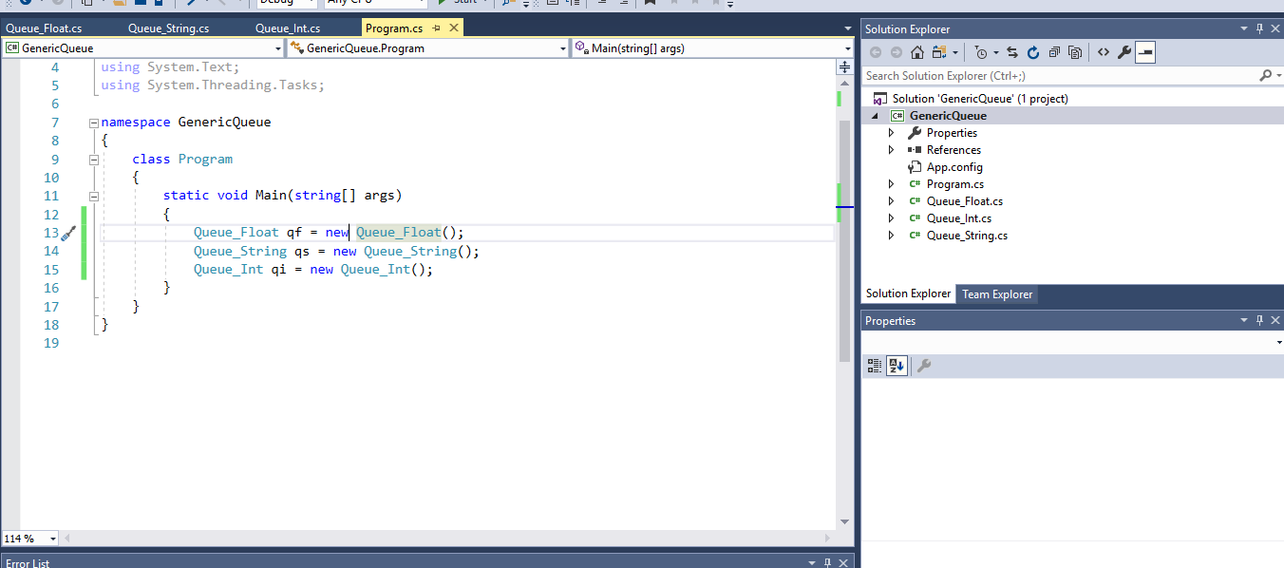
The wrong way

Slide 5
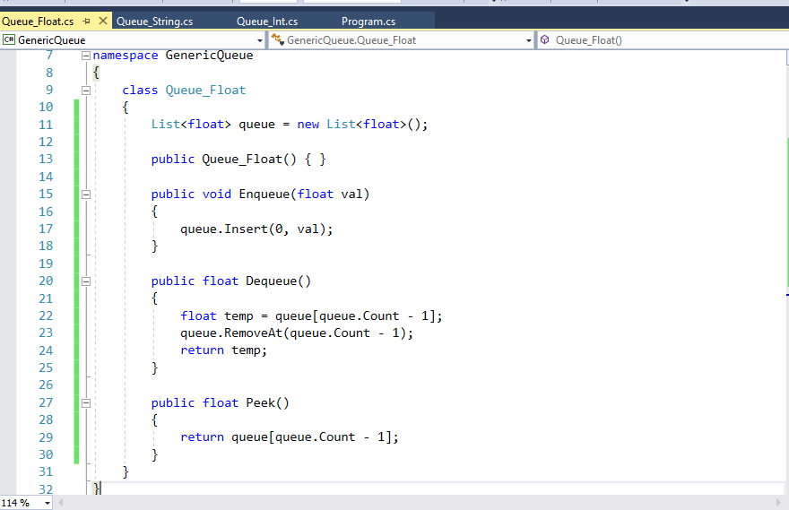
The wrong way

Slide 6
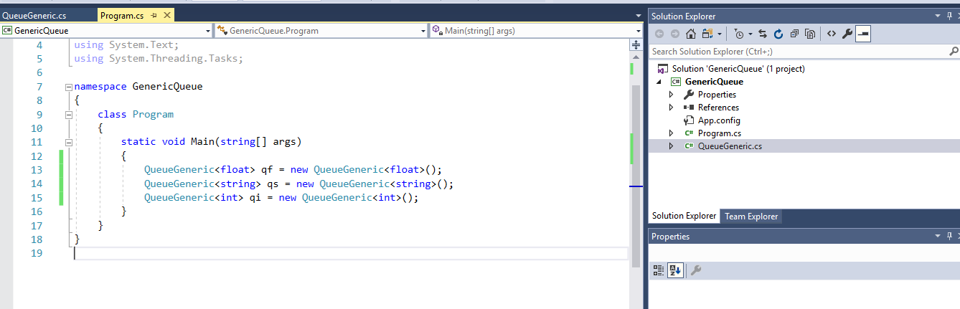
The right way

Slide 7
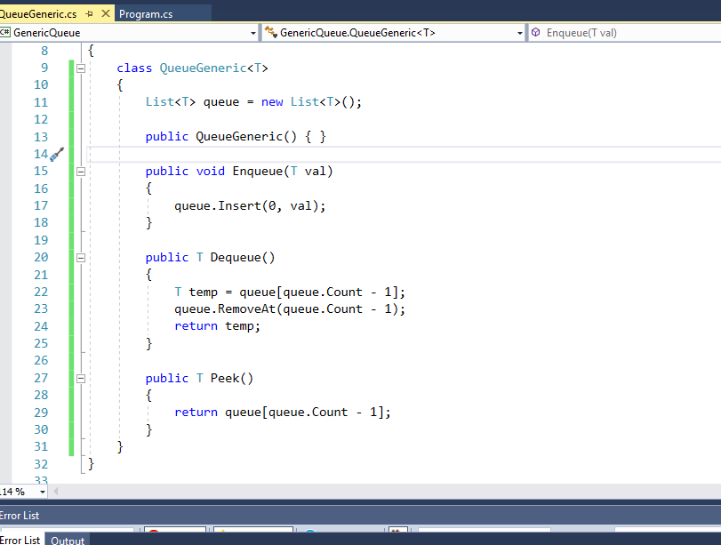
The right way

Slide 8
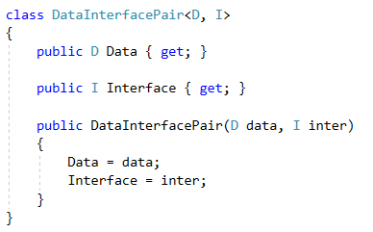
Generics with multiple types
Ties two data structures together in a meaningful way.

Slide 9
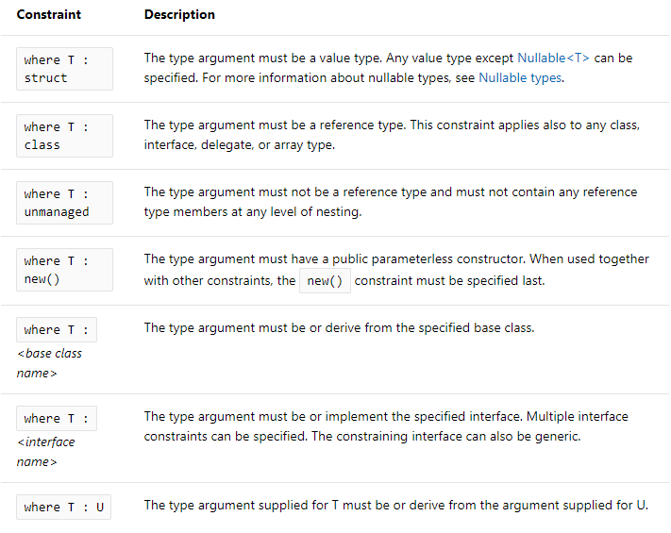
Requiring details on T
Sometimes we want to require that our generic variables have some specific detail.
This limits the otherwise limitless benefits of a generic class, but is more often than not a good thing!

Slide 10
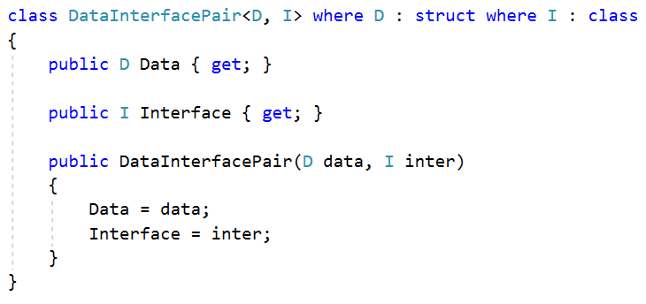
I want my data element to be simply data… No behaviors.
My interface element, however, might have some behaviors that will help display the data.

Slide 11
Examples of Generics you might know
List<T>, Queue<T>, Stack<T>
Dictionary<K, V>
KeyValuePair<K, V>
LinkedList<T>

Slide 12
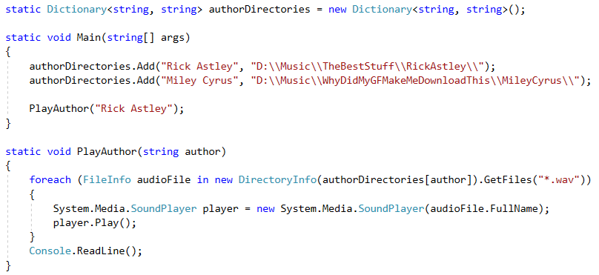
KeyValuePair<Key, Value>

Slide 13
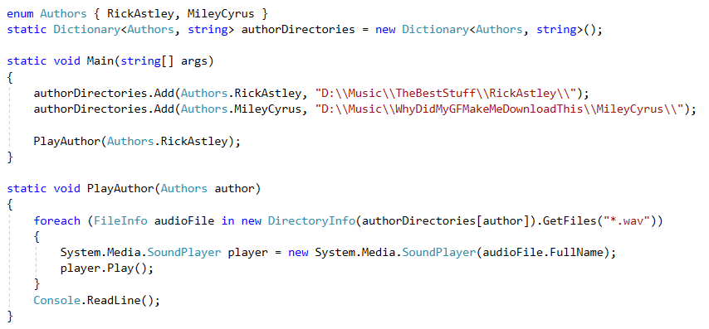
Using enums in Dictionaries

Slide 14
Example, AudioManager
https://github.com/darrare/Archive-12-2018/blob/master/Unity/AllUnityWork/Platformer/Platformer/Assets/Scripts/Managers/AudioManager.cs

Slide 15
Generic Methods
Instead of writing a method 50 times for 50 different data types, write it once!

Slide 16
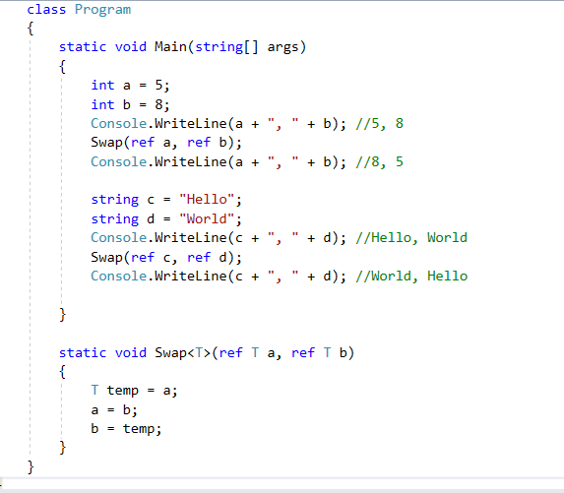

Slide 17
Interfaces
Similar to abstract classes.
Forces an object to implement certain behaviors.
Creates polymorphism among similar objects.
While you can only ever inherit from 1 class, you can inherit from unlimited interfaces.

Slide 18
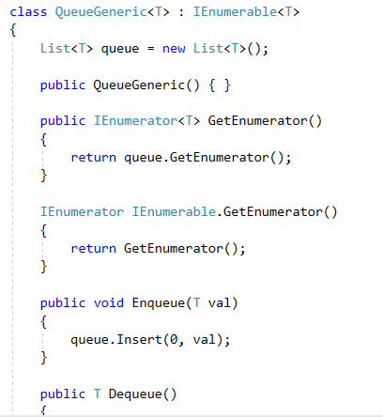
IEnumerable
Very common.
Forces your class to be enumerable
Enumerable means that it can be iterated through (like a list).

Slide 19
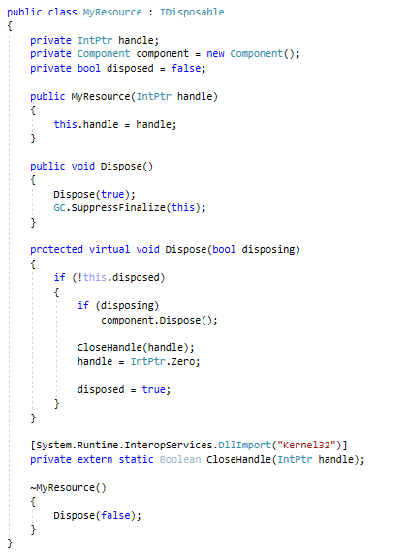
IDisposable
Implemented by StreamReader and StreamWriter.
Allows us to put our structure into a “using” statement.

Slide 20
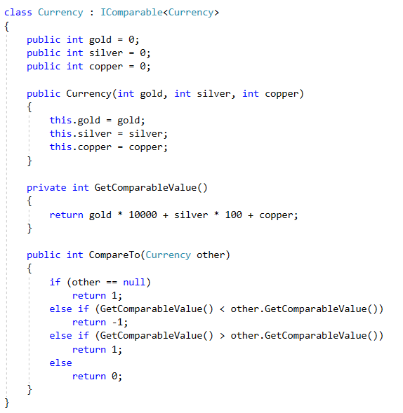
IComparable<T>
A generic interface that allows us to compare two of the same object

Slide 21
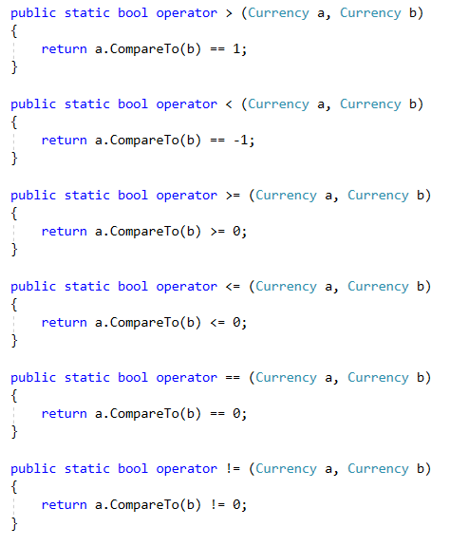
IComparable<T> extended
The ability to call .CompareTo() is nice and all, but the default operators will be much more easy to read and usable.

Slide 22
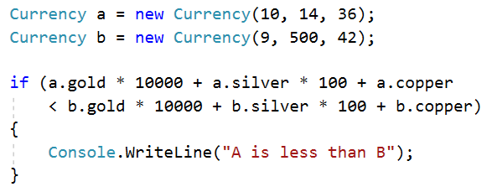
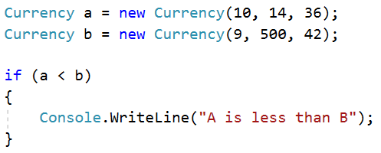
Before vs After, IComparable

Slide 23
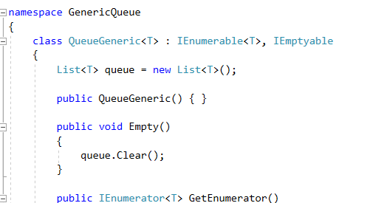
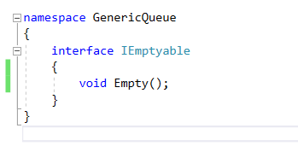
Custom Interfaces
Lets us dictate what we can and cannot do with our code.

Slide 24
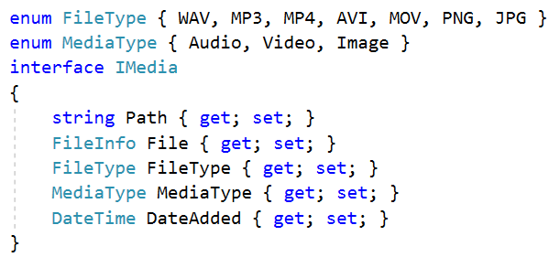
Custom Interfaces

Slide 25
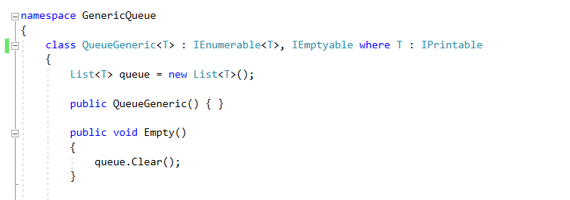
Requiring behaviors of T
Sometimes, you want to require that every generic class “T” that you handle has certain behaviors.
Perhaps we want every type of T to be easily printable.
So we require that every T inherits from IPrintable

Slide 26
Media Demo
Framework for a media managing program.

Slide 27
Lab – Binary Tree
On Canvas, there is a project download that contains a simple binary tree that considers only integers.
Your goal is to modify it to do the following:
Accept any object type.
Remain a sorted binary tree (not balanced, just sorted)
Allow the developers to iterate through the tree with foreach

